Slide 1

TEEGALA KRISHNA REDDY ENGINEERING COLLEGE
Department of Computer Science
and Engineering
HEAD OF THE DEPARTMENT
Dr. Ch. Venkata Phani Krishna (Professor)
PROJECT COORDINATOR
Mrs. J. Rachana (Asst.Prof)
Mrs. MD. Salma (Asst.Prof)

Slide 2
TITLE
ONLINE VOTING SYSTEM
INTERNAL GUIDE
Y. SHIVASREE(Asst.Prof)
TEAM MEMBERS
B. NIKITHA (16R91A0508)
G. KAMAL YESHODHAR SHASTRY (16R91A0522)
S. SAI KUMAR (16R91A0557)

Slide 3
CONTENTS
Abstract
Existing System
Literature Survey
Proposed System
System Requirements
Functional Requirements
Non-Functional Requirements
System Architecture
UML Diagrams
Modules
Testing
Sample Source Code
Database Description
Screenshots
Future Enhancement
Conclusion

Slide 4
ABSTRACT
In traditional elections, voter has to go to the polling station in person to cast his/her vote. In the proposed online system voter can cast his vote directly from the place he lives without being attending the polling station. Voting is done through this application using internet by logging in using username and password.

Slide 5
EXISTING SYSTEM
Traditional voting is done using either Ballot Papers or Electronic Voting Machines(EVMs). In the elections following this system, voter has to attend the voting booth in person to cast his vote. And the result of this system is declared after manually counting the number of votes polled to each candidate.
Disadvantages:
Illegal voting and rigging is possible.
Man power required for the conduction of elections is high.
Number of votes casted may be low due to disinterest of voters to travel to far away places
Result declaration will be delayed.

Slide 6
Literature survey
As per the surveys conducted, major reasons given by the people for not participating in the elections is that unwillingness to travel to distant places to vote in elections. And another issue is that wastage of lot of time, money and man power for conducting the elections is not encouraging in the upcoming age of a digital life. Hence, to enable people to exercise their duties and rights for the democratic society by casting their votes an online based platform is required to conduct the elections providing necessary privacy and security which gives accurate and fast results.

Slide 7
PROPOSED SYSTEM
The proposed Online Voting System is a web application consisting an online platform in which a voter can cast his/her vote from anywhere using internet. For this voter has to register himself/herself for Voting using a user name and password using which he/she will login to the system on assigned dates to cast his/her vote.
Advantages:
There is no need for the voter to travel to their home constituency to cast his/her vote.
Major benefit of this system is that it increases voting percentage dramatically.
Saves time and money required for the travelling.
Illegal voters can be removed by the admin by cross checking the details
It maintains the privacy as even admin cannot link the -ballot to the person from which the vote is casted.
Election results can be declared instantaneously.

Slide 8
SYSTEM REQUIREMENTS
Hardware Requirements:
Processor | : | Pentium core 2 duo or similar/advanced
Hard Disk | : | 50 GB or more
RAM | : | 512 MB or more
Software Requirements:
Operating System | : | Windows 7 or above or Linux
Programming Language | : | Java/J2EE
User Interface | : | HTML, CSS
Client-Side Scripting | : | JavaScript
Server Deployment | : | Apache Tomcat 7.0
Database | : | MySQL
Software | : | JDK 1.7
Web Applications | : | JDBC, JSP, Servlets

Slide 9
FUNCTIONAL REQUIREMENTS
Voter and Candidate Registration.
Secure Login for both Voters, Candidates and Election Administrator .
Candidate and Voter Management
Voting.
Result Declaration.

Slide 10
NON-FUNCTIONAL REQUIREMENTS
Security
Reliability
Usability
Portability
Performance

Slide 11
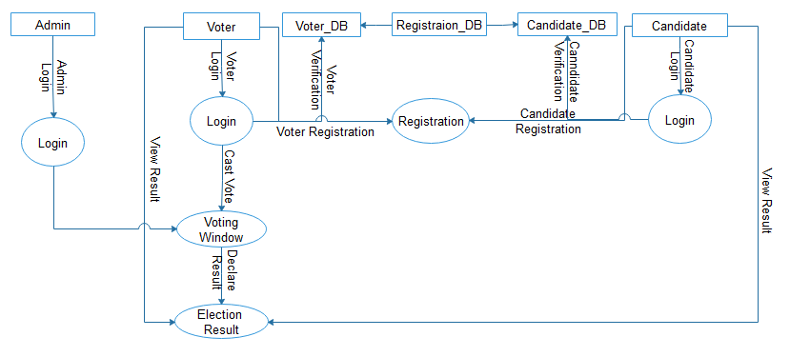
SYSTEM ARCHITECTURE

Slide 12
Uml Diagrams
Use Case Diagram
Class Diagram
Sequence Diagram

Slide 13
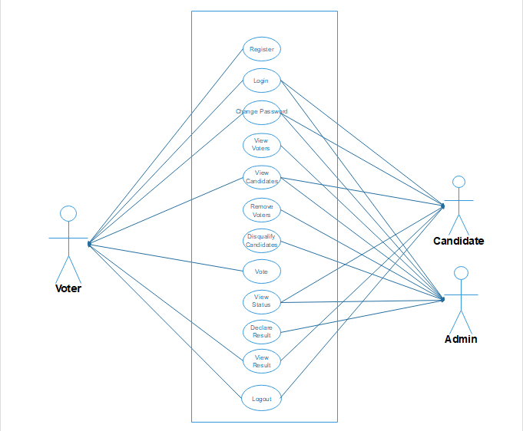
USE CASE DIAGRAM

Slide 14
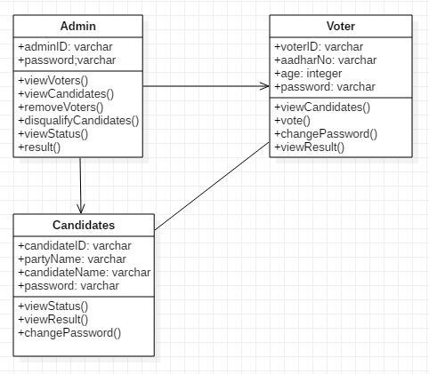
CLASS DIAGRAM

Slide 15
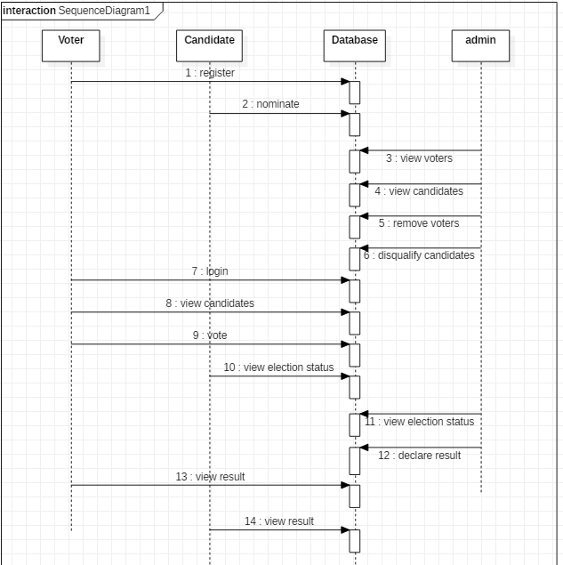
SEQUENCE DIAGRAM

Slide 16
MODULES
Online voting system application consists of the following modules:
Voter Module
Candidate Module
Admin Module
Voting Module
Reports Module

Slide 17
Voter Module:
A user can register himself/herself as a voter to the Election commission database in the assigned time period.
A voter once approved by the admin/election commissioner can login into the application.
A voter can see the basic information of the candidates participating in the elections.
A voter can cast his vote by selecting desired candidate from the list from the voting page.
A voter can view the result of the elections after completion of the elections.

Slide 18
Candidate Module:
A user can nominate himself/herself to participate in the elections in the assigned time period.
A candidate once approved by the admin can login into the application.
A candidate can view details of all other candidates nominated for the elections.
A candidate can view the live election status.
A candidate can view the result of the elections after completion of the elections.

Slide 19
Admin Module:
Main functionality of the admin is to manage the election procedure.
Admin starts and stops the various procedures in the election like registration, nomination, voting procedure and declaration of results.
Admin has to approve the voters registered to the database and has right to remove the voters if he/she violates criteria of eligibility.
Admin receives the nominations from candidates and approves them and has right to disqualify the candidates if he/she violates criteria of eligibility.
Admin can view the live election status.
Admin has to declare the results of the elections.

Slide 20
Voting Module:
This module consists of a Election interface which shows
The list of candidates participating in the elections.
An interface which allows a voter to select a candidate from the list shown.
A message giving confirmation to the voter about the candidate for whom his/her vote has been casted.

Slide 21
Reports Module:
This module has the following functions:
It automatically counts the number of votes casted for each candidate.
It shows list showing the number of votes received by each candidate.
It decides which candidate achieved maximum number of votes.
It declares the candidate who got maximum number of votes as the winner of the election when approved by the admin.

Slide 22
Testing
Testing is the process of trying to discover every conceivable fault or weakness in a work product. It provides a way to check the functionality of components, sub assemblies, assemblies and/or a finished product.
The purpose of testing is to discover errors.
The system has been tested whether it meets the requirements and user expectations and does not fail in an unacceptable manner.
The prepared Voting system has been tested with various test cases.
Various scenarios of the elections has been conducted to check semantic errors in the system.
All the modules including the database is tested successfully.

Slide 23
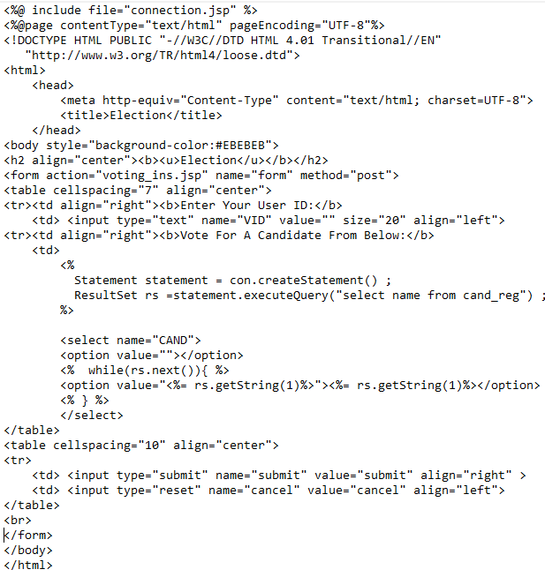
Sample code

Slide 24
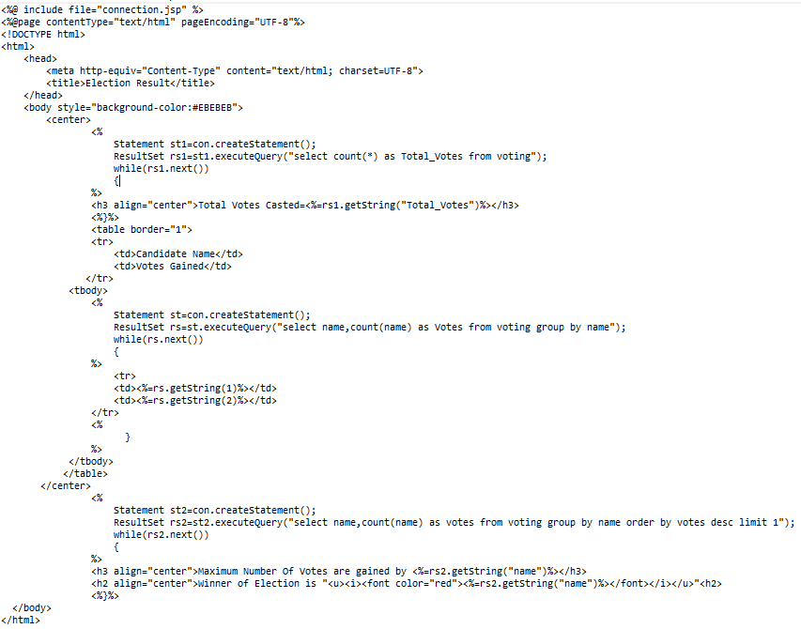

Slide 25
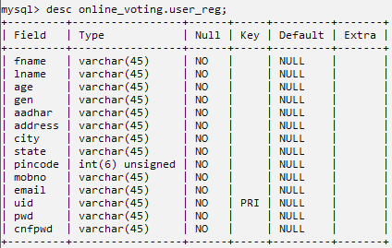
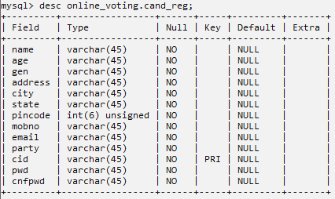

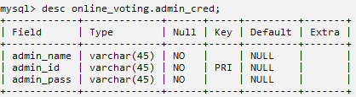
Database Description

Slide 26
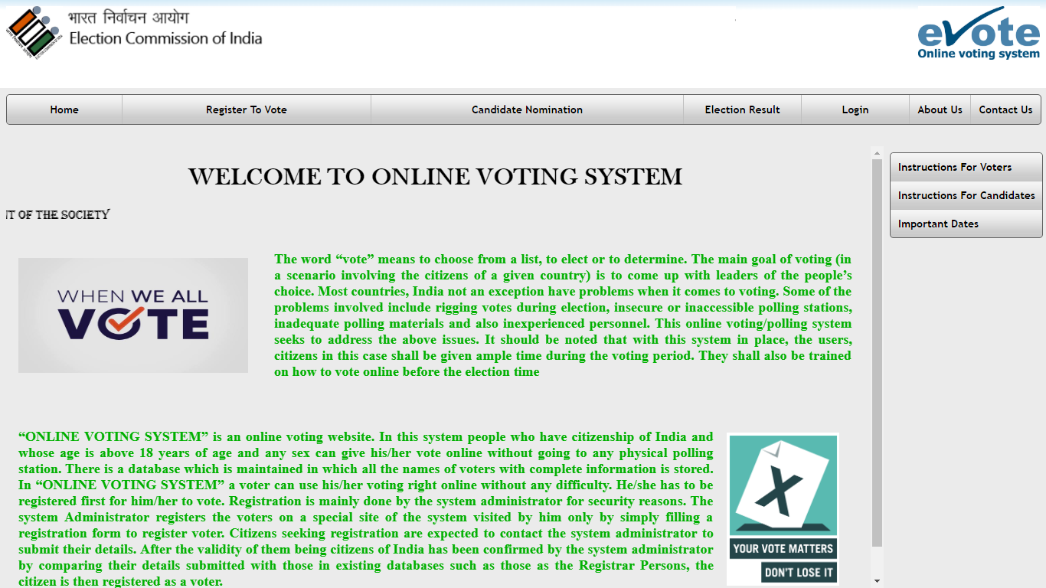
screenshots

Slide 27
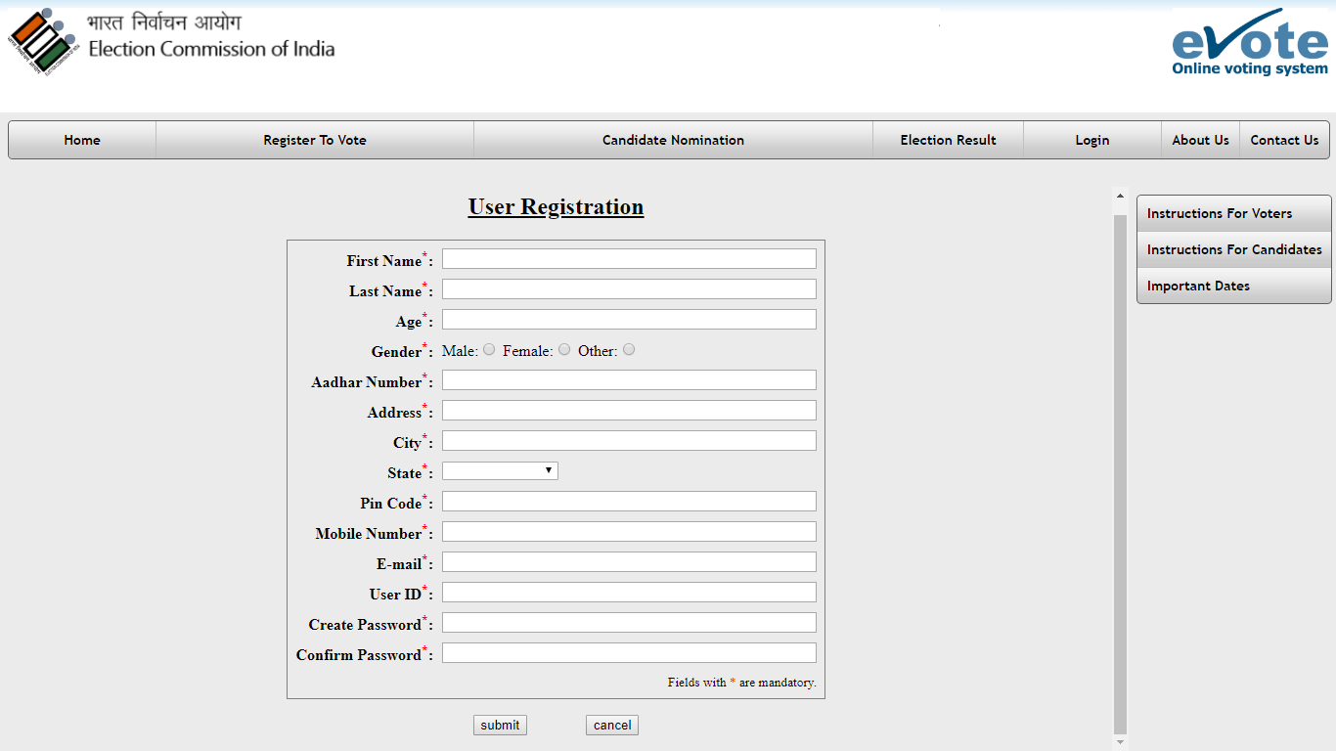

Slide 28
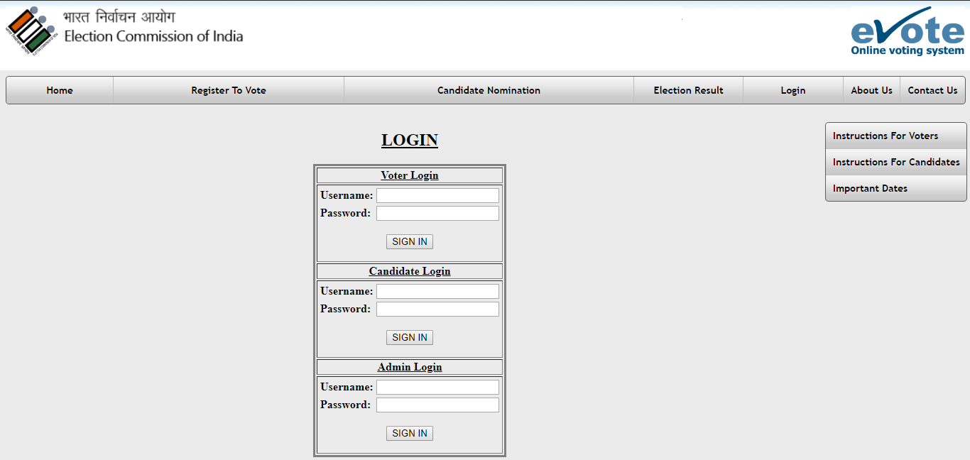

Slide 29
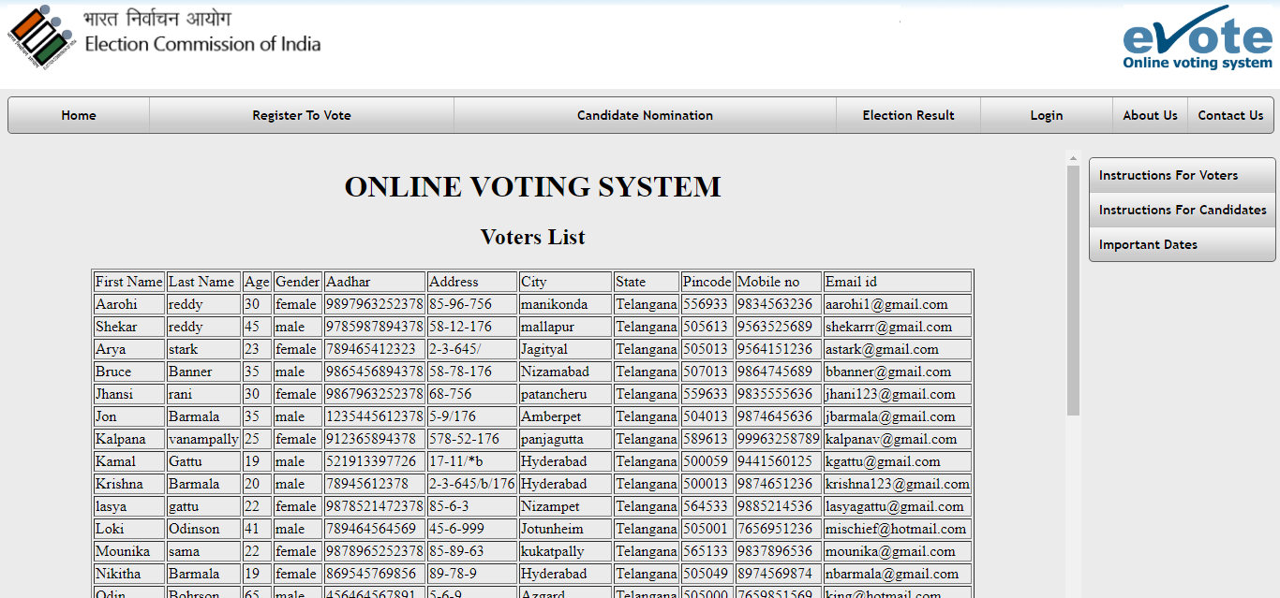

Slide 30
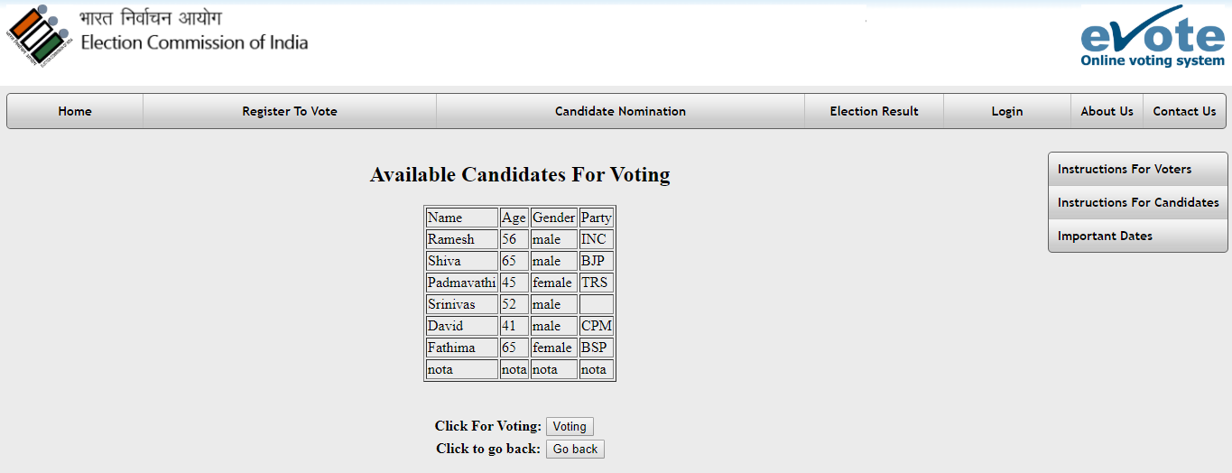

Slide 31
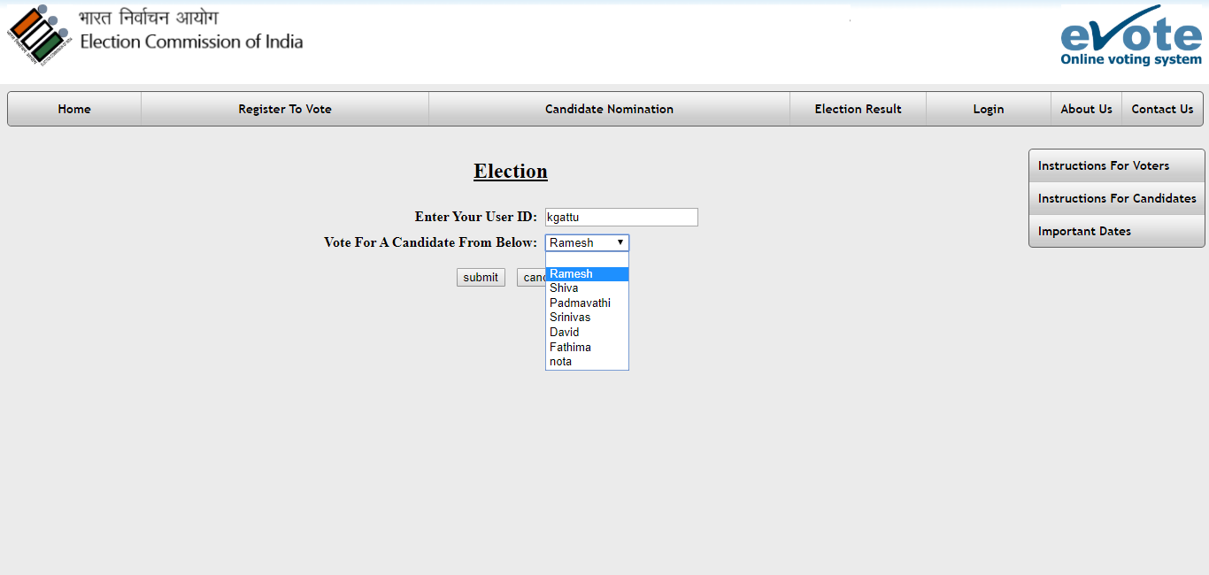

Slide 32
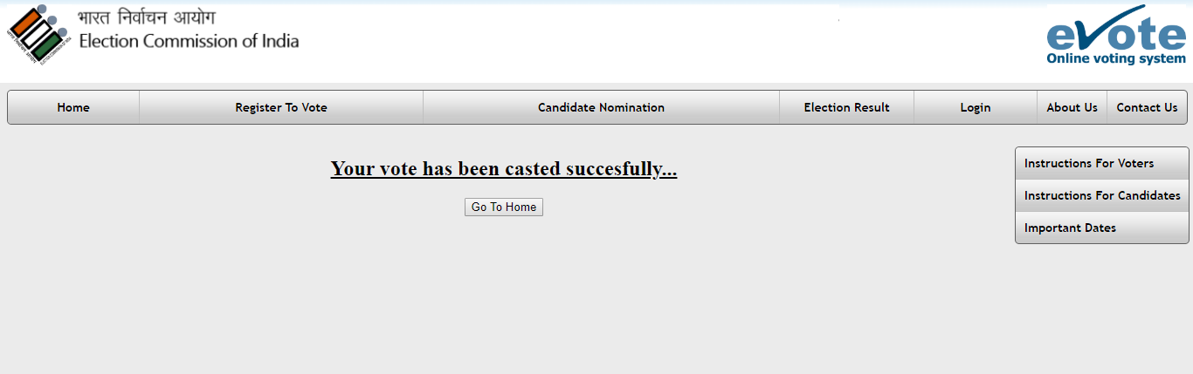

Slide 33
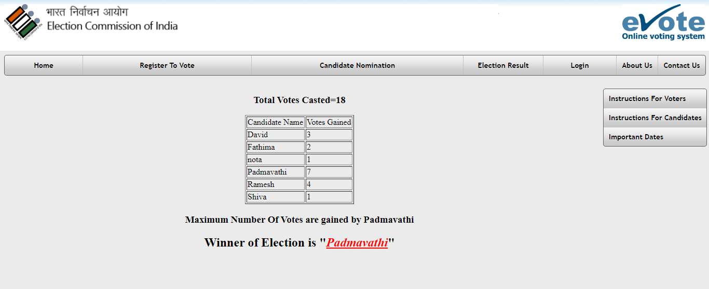

Slide 34
Future enhancement
The project developed hereby is developed with a provision to conduct elections for a single area and for a single designation. This can be extended such that it provides different platform for each and every constituency and for every designation, and navigates automatically to the home constituency page of elector based on his/her address.
Provide various security features by using checking with biometric data of the voters.
To interconnect with Police Department to verify the various criminal records of nominated candidates.

Slide 35
conclusion
A secure platform is created for enabling voters to cast their vote in the elections from anywhere in the assigned time using internet is created.

Slide 36
Thank You..☺
ANY QUERIES ?

